Slide 1
Online Shopper’s Intention
How to best optimise the customer’s online experience?
CS- 513 A KDD -Final Project

Slide 2



presented by
Prithiv Dev Devendran 10453922
Shreya Vhadadi 10453495
Chran Suresh 10450732

Slide 3
The customer goes through a series of chronological steps to making a purchase in an E-commerce website. These steps are tracked down and classified to know a purchased is made. From this problem we seek to find the crucial part of the decision making process and improvise the outcome.
Problem Statement

Slide 4
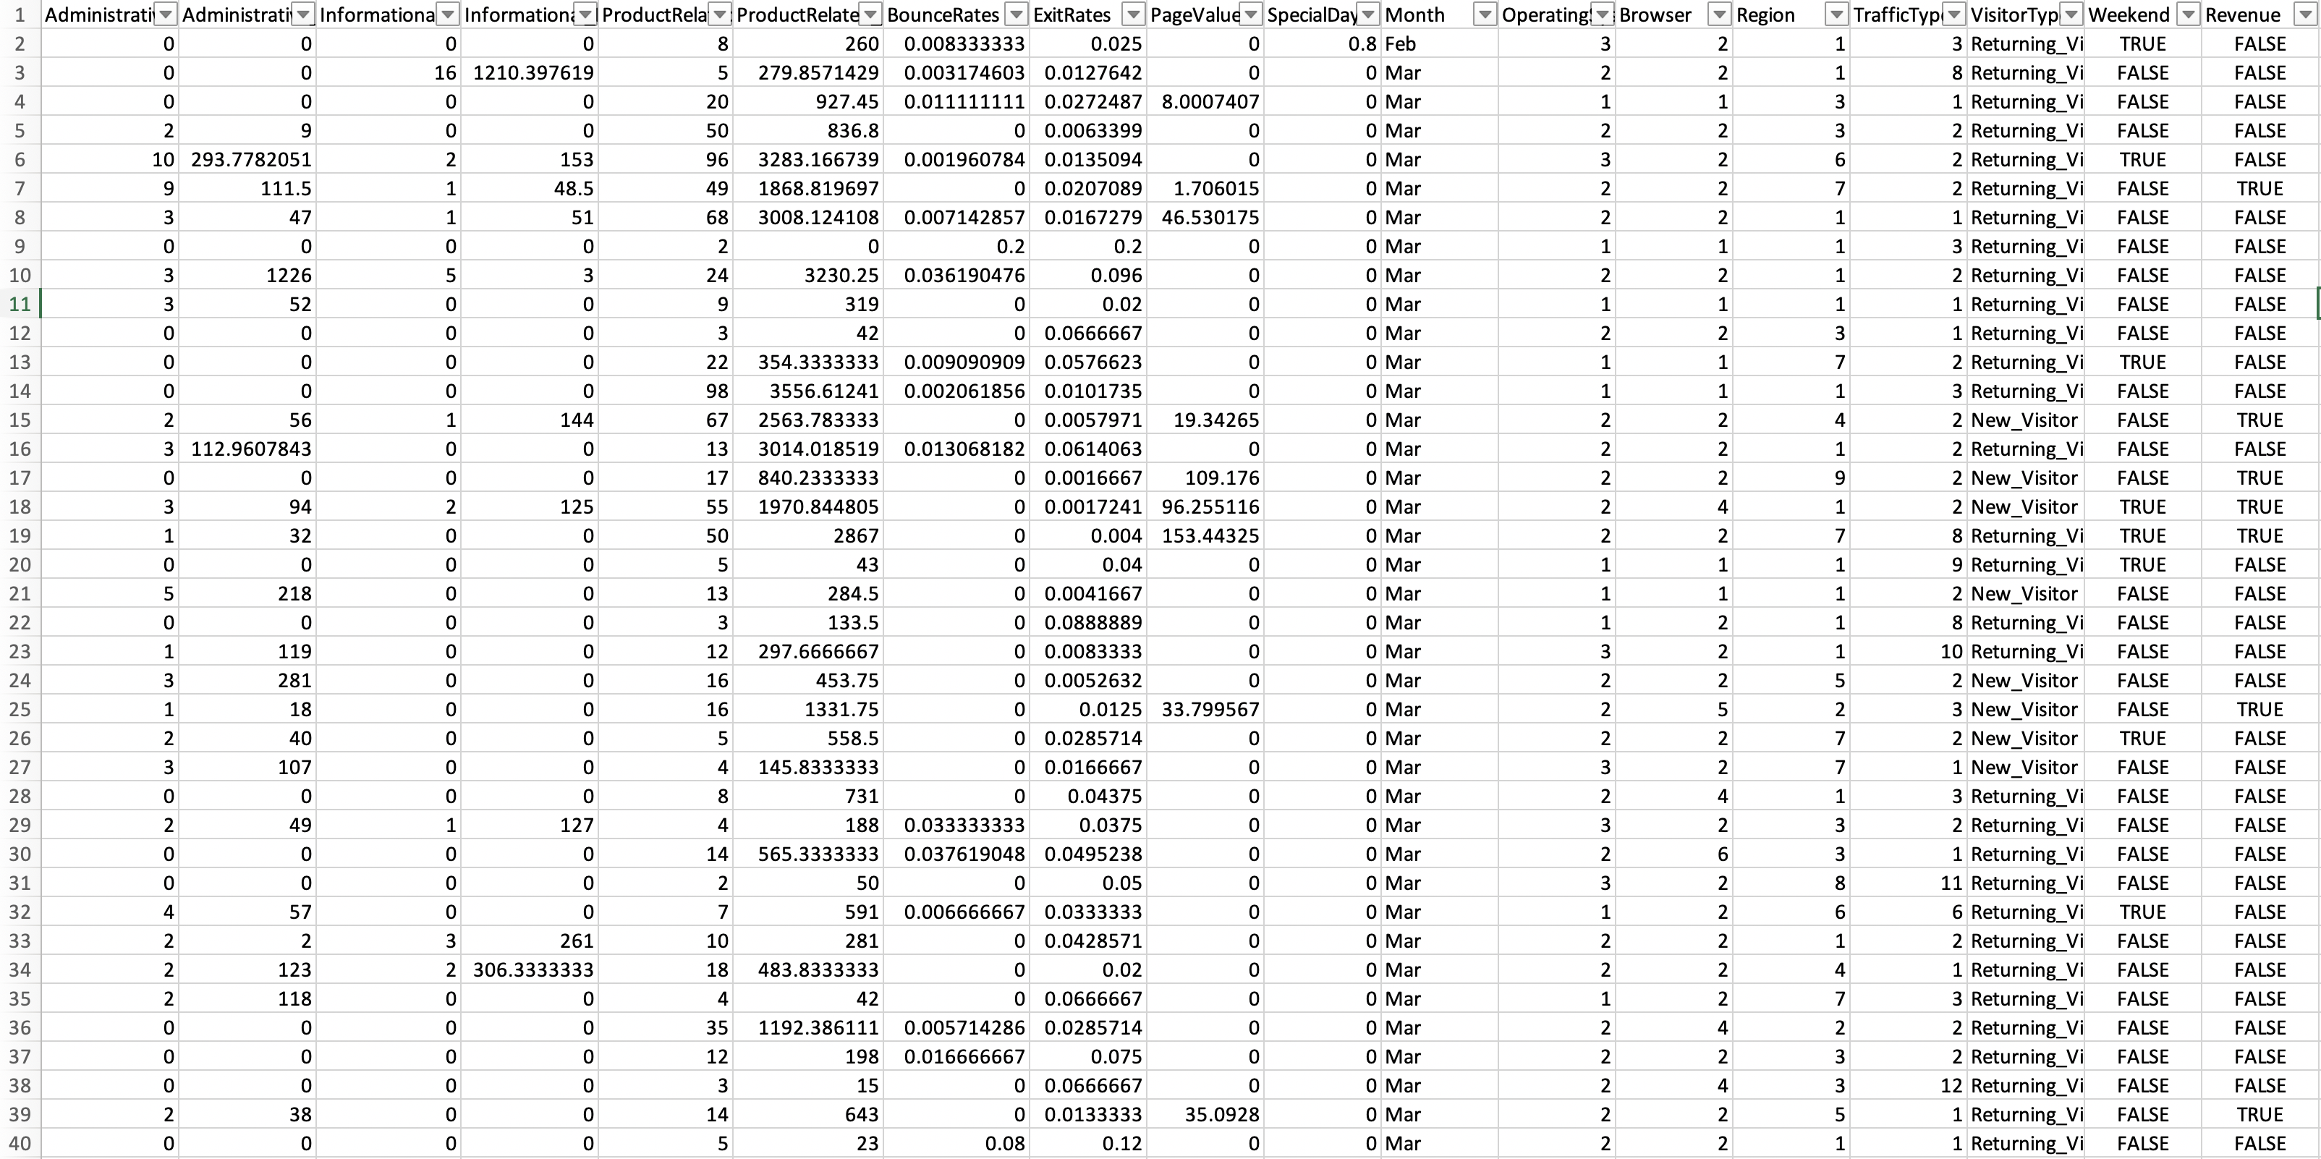
Dataset from Kaggle

Slide 5
Legend
Feature | Description
Administrative | The page relating to Administrative setup.
Administrative_Duration | Time spent viewing the Administrative page.
Informational | The page relating to Profile info.
Informational_Duration | Time spent viewing the Informational page.
Product Related | Cost of the product in dollars viewed by the customer
Product Related_Duration | Time spent viewing the Product_Related page
Bounce Rate | Percentage of visitors to a particular website who navigate away from the site after viewing only one page.
Exit Rate | Percentage of visitors to a page on the website from which they exit the website to a different site. ifferent website.
Page Values | Average value for a page that a user visited before landing on the goal page or completing an transaction.
Special Day | Holidays, festival days
Month | Month of the year
OS | Operating System used
Browser | Web page terminal
Region | Location of the customer
Traffic Type | How users arrived to that site
Visitor Type | Type of visitor
Weekend | Weekend or not
Revenue | Revenue will be generated or not

Slide 6
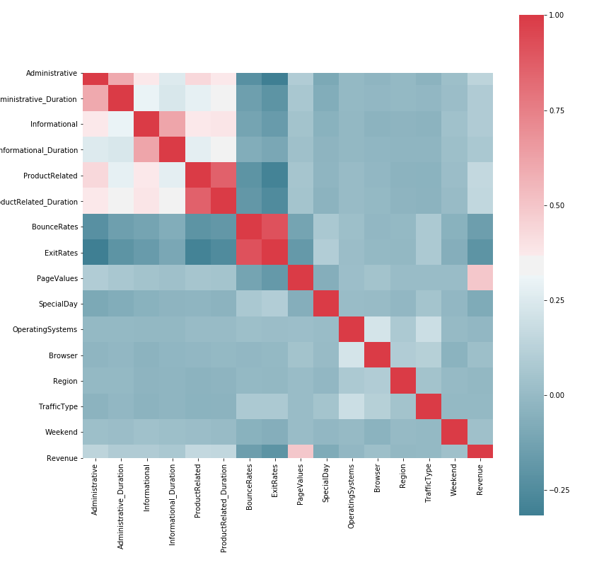
Exploratory Data Analysis
The plotted graph shows the correlation matrix between the features in the dataset.
The “PRODUCT_RELATED” and “PRODUCT RELATED _DURATION” have considerable amount of correlation between them but we felt the cost of the product need not be related to the amount of time spent on the product.
The “BOUNCE RATE” and “EXIT RATE” also have high correlation but weren’t removed because they were similar aspects of the dataset but represented two important factors of the dataset.

Slide 7
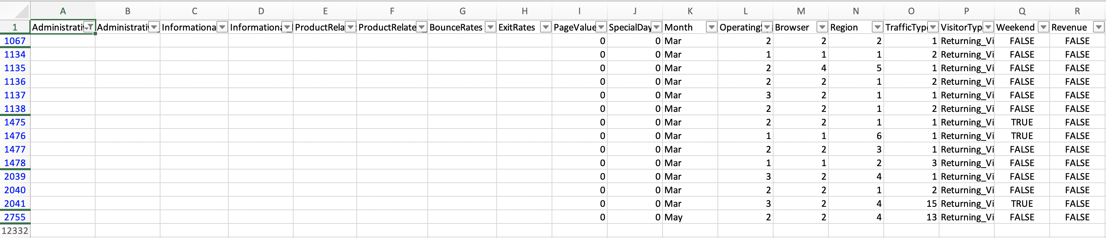
Pre-processing
There are 14 missing values in each and every column where all the values are from the same record.
Due to this fact we removed them, since didn’t want to make imputations that would drastically make modifications.
We changed the text data into discrete numeric values.
We changed the Class labels - Revenue-False to be 0 and Revenue-True to be 1.

Slide 8
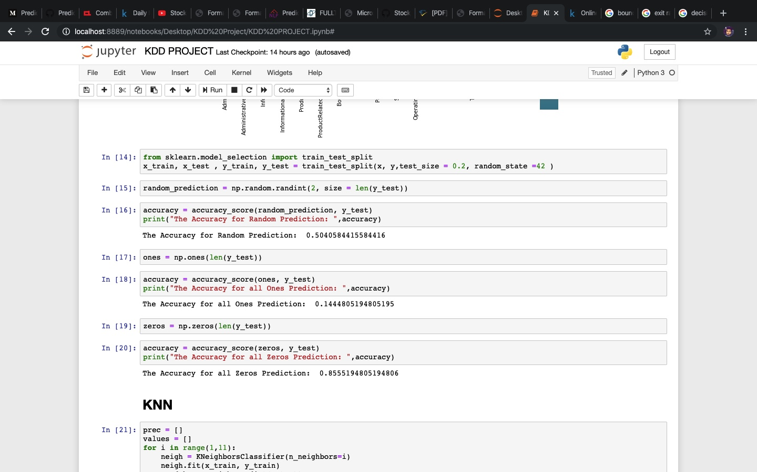
Baseline Model
Baseline Model
Y Test | Random
0 | 0
0 | 1
0 | 0
1 | 0
Y Test | Ones
0 | 1
0 | 1
0 | 1
1 | 1
Y Test | Zeros
0 | 0
0 | 0
0 | 0
1 | 0
The first tabulation shows random prediction for the output.
The second tabulation shows all zeros prediction for the output.
The third tabulation shows all ones prediction for the output

Slide 9
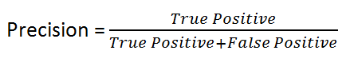
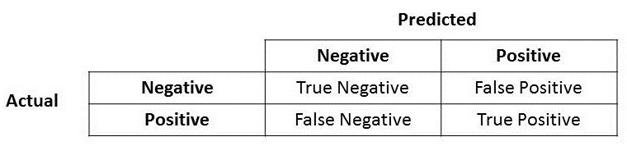
Intuition from the baseline
It is evident that the dataset is imbalanced.
Finding accuracy can actually mislead the prediction of this classification problem.
Thus from this understanding we can use precision as an evaluation metric to find how good each of our class is classified.
Precision has two factors : true positive and false positive.
True positive - correctly predicts the positive class.
False positive - mis-predicts the positive class.

Slide 10
Model
Naive Bayes
KNN
Decision Tree
K Means
ANN
Random Forest

Slide 11
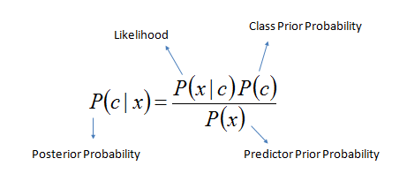
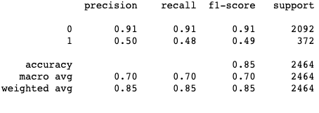
Naive Bayes
We have a naive assumption that each column is independent of each other and the conditional probability with respect to the classes are calculated.
The precision for the Revenue - False(0) has considerably bet the baseline model(random).
The precision for the Revenue-True(1) is at par with baseline model.

Slide 12
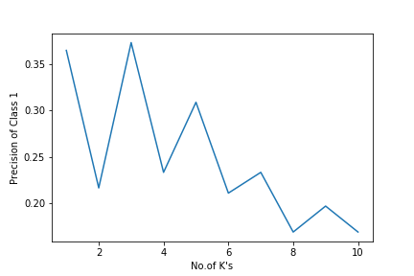
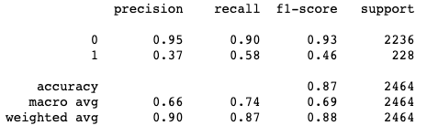
K Nearest Neighbour
 | Revenue - True | Revenue - False
1 | 0.91 | 0.37
2 | 0.98 | 0.22
3 | 0.95 | 0.37
4 | 0.98 | 0.23
5 | 0.97 | 0.31
6 | 0.98 | 0.21
7 | 0.98 | 0.23
8 | 0.99 | 0.17
9 | 0.98 | 0.20
10 | 0.99 | 0.17
Model was iterated for 1 to 10 neighbours
The precision for Class 0 was relatively high than Class 1
In the below graph every odd K values tend to shoe more precision because of the fact that the problem is a binary classification problem.

Slide 13
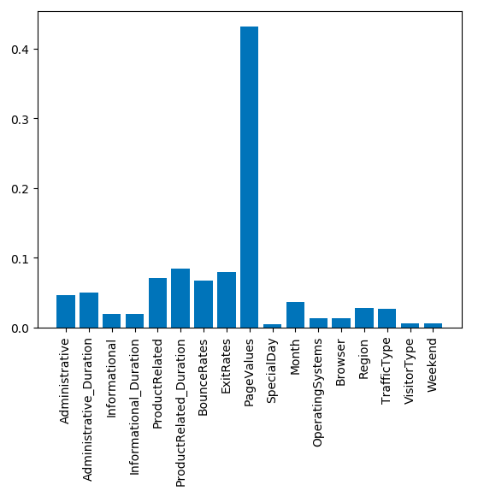
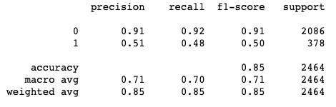
Decision Tree
Similarly like Naive Bayes, Decision Tree has surpassed the baseline model for Revenue-False(0), but on par with the baseline model for Revenue-True(1).
This model is on par with NB.
From this model the most important features used to build the model is extracted and plotted.
In which “PAGE VALUE” seems to be the most important attribute for classifying.

Slide 14
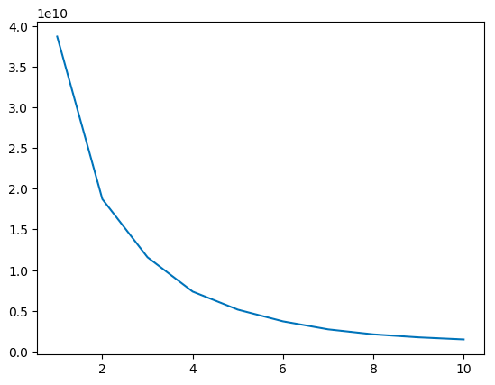
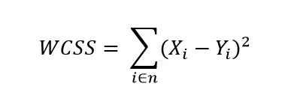
K Means
K Means is an unsupervised model that groups the features into clusters.
To find the optimal number of clusters we draw the elbow curve using the WCSS-Within Cluster Sum of Squares.
WCSS is a statistical method to compute the difference in the square of distances between the centroid and the points in cluster.
The goal is to have minimal number of clusters with minimal WCSS.

Slide 15
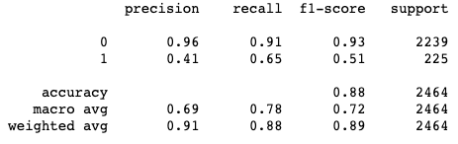
Artificial Neural Network
Comparing with the other models and baseline, ANN has performed well for Revenue-False(0), but has failed to beat the baseline in Revenue-True(1).
This model was built with 8 hidden layers, with learning rate 0.0001 and optimiser to be Adam.
All the parameters are used with hyper tuning, i.e., the parameters were tried with trial and error.
Models with higher or lower hidden layers tend to fail with perfect precision for the Revenue-False(0) and no precision on Revenue-True(1)

Slide 16
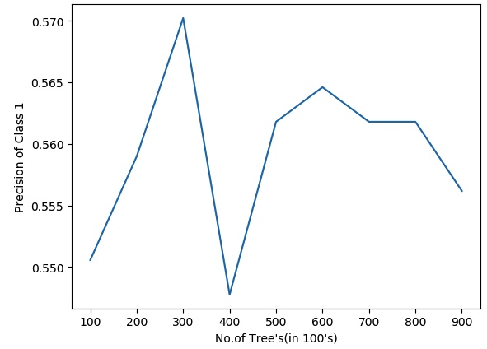
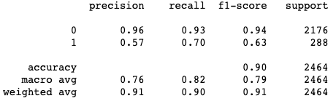
Random Forest
No of Trees | Revenue - False | Revenue - True
100 | 0.96 | 0.55
200 | 0.96 | 0.56
300 | 0.96 | 0.57
400 | 0.96 | 0.55
500 | 0.96 | 0.56
600 | 0.96 | 0.56
700 | 0.96 | 0.56
800 | 0.96 | 0.56
900 | 0.96 | 0.56
1000 | 0.96 | 0.56
Till now the best model had been the DT and NB, where RF is and extension(ensemble) of many DTs.
The tabular column shows that the Revenue-False(0) to be constant irrespective of the number of trees and the Revenue-True(1) tends to be increasing till 300 trees and then stays constant.
So ultimately 300 trees seem to be optimal solution for this ensemble method.
The precisions seems to have considerably increased with respect to the DT and NB.

Slide 17
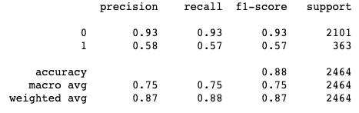
Conclusion
From the tabulation it is evidently seen that Random Forest is the best classification model for our dataset.
So we decided to train our RF model with only the most important features which was “PAGE VALUES” and “EXIT RATES” and we found out the precision for the Revenue-True class decreased by .03
Instead of having 17 features to actually predict the model, predicting merely the same accuracy with two features found to be more effective for the business.
Model | Revenue-False | Revenue-True
Baseline-Random | 0.50 | 0.50
Naive Bayes | 0.91 | 0.50
KNN | 0.95 | 0.37
Decision Tree | 0.91 | 0.54
ANN | 0.96 | 0.41
Random Forest | 0.93 | 0.58

